Slide 1

Health and Safety in Office Environments
Presented by Thomas Faulkner

Slide 2
Learning Objectives
Identify and understand the leading causes of office accidents and common safety hazards.
Learn strategies to prevent accidents and mitigate safety risks in the workplace.
Understand the principles of ergonomics and their importance in reducing workplace strain and injury.
Learn how to set up and maintain an ergonomic workstation and recognize ergonomic-related issues.
Identify common causes of slips, trips, and falls in the office.
Understand the components of a comprehensive emergency action plan and the steps to take during emergencies.
Learn the importance of regular emergency drills and training to ensure preparedness.
Identify common health risks associated with prolonged office work and learn how to mitigate them.
Recognize the role of workplace culture in accident prevention and overall safety.
Encourage open communication and regular safety inspections to maintain a safe and healthy office environment.

Slide 3
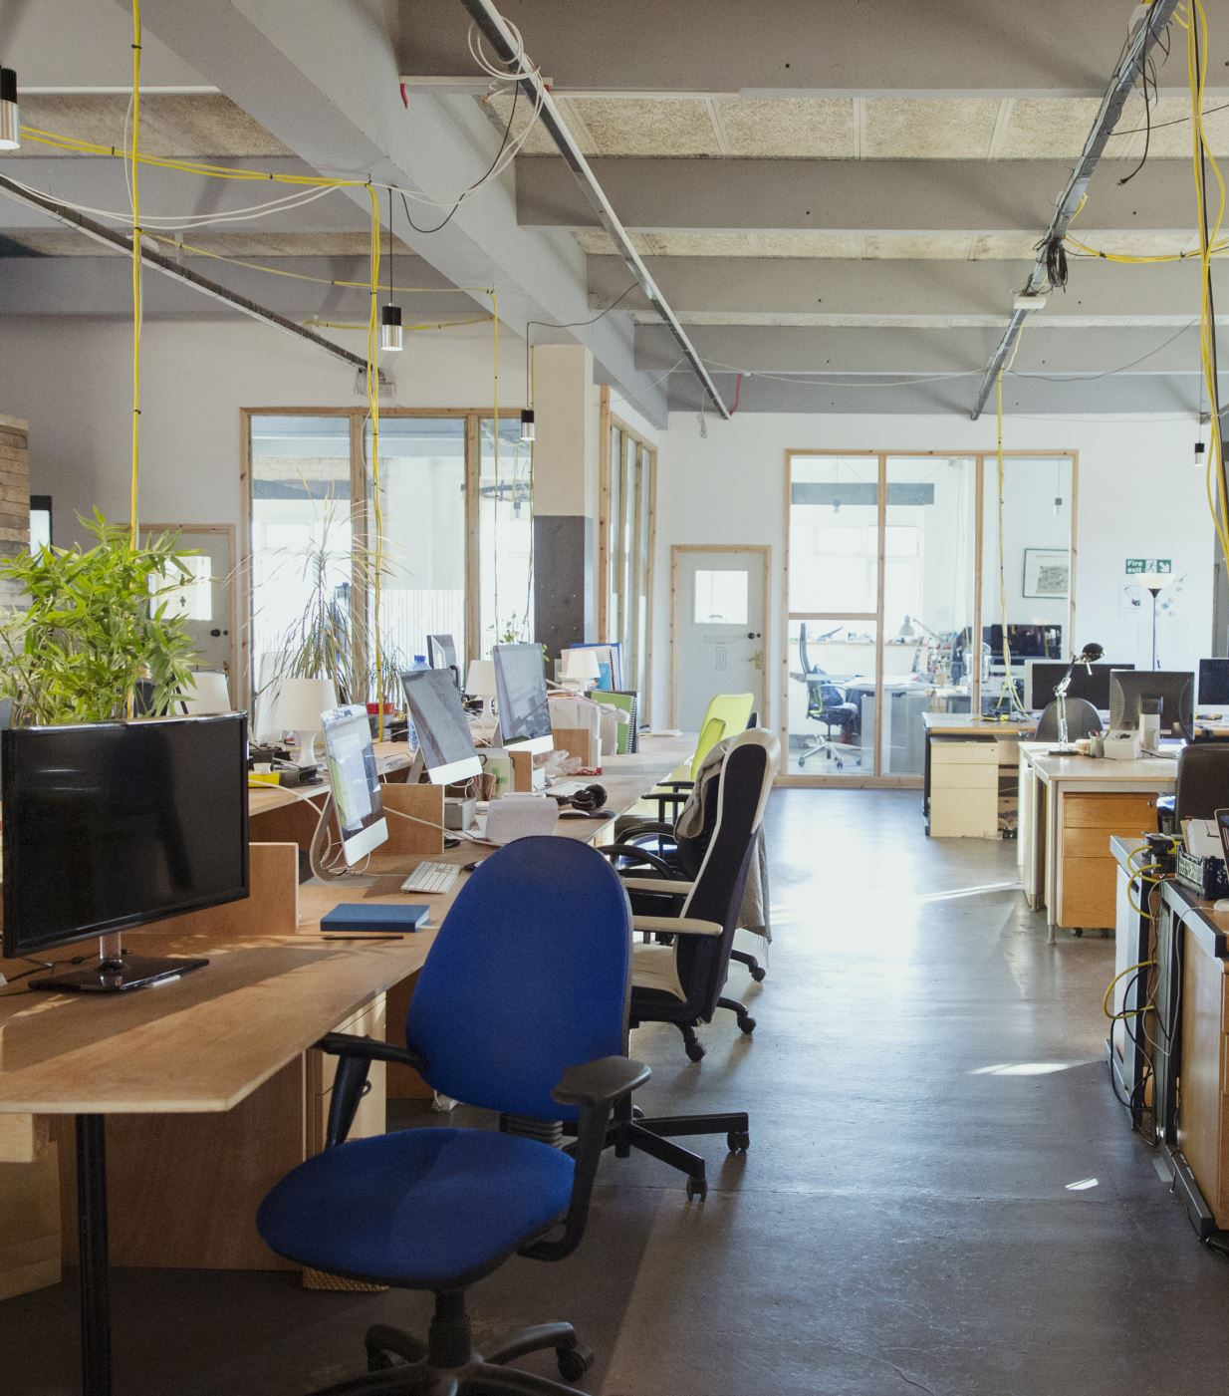
Office Safety
Offices of today are very different from the way they were 20 years ago.
Many hazards exist within an office environment that can cause injuries and health problems.
Slippery floors, open file drawers, poor lighting and machines that can emit noxious/hazardous gases are just some of the hazards that can be encountered.
Appropriate steps need to be taken to control and eliminate hazards and safety issues.

Slide 4
Leading Office Accidents
Falls
Strains and over-exertion
Struck by or striking objects
Caught in or between objects
Foreign substances in eyes
Burns from hot liquids/fires
Electrical shock

Slide 5
Common Office Hazards
Fire Hazards
Electrical Equipment
Office Furniture
Office Machinery
Handling/Storage Hazards
Ventilation
Illumination
Noise
Physical Layout
Exits/Egress
Ladders
Stands
Stools
Office Tools
Copying Machines

Slide 6
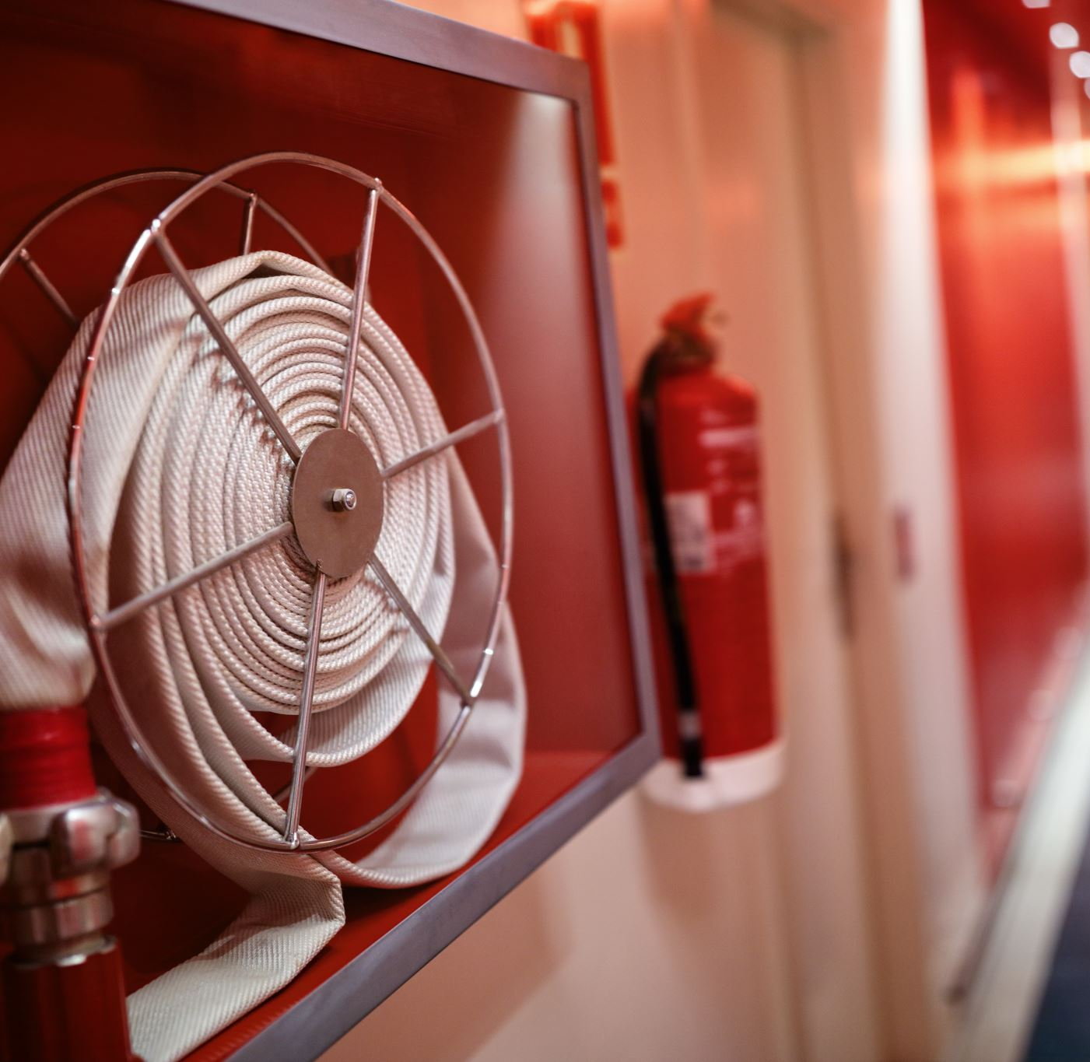
Fire Hazards
Store unused records/papers in fire resistive files or vaults.
Use flame-resistive materials.
Smoke only in designated areas and use proper ashtrays.
Fire extinguishers and fire alarm pull stations should be clearly marked and unobstructed.
Flammable liquids should be kept to a minimum and stored in a metal cabinet.
Fire doors should be kept closed at all times
Do not hang anything from/on sprinklers, smoke detectors, heat detectors.
Keep storage at least 18 inches from sprinkler heads.
Report electrical hazards immediately (e.g. sparking outlets, damaged plugs, etc.).

Slide 7
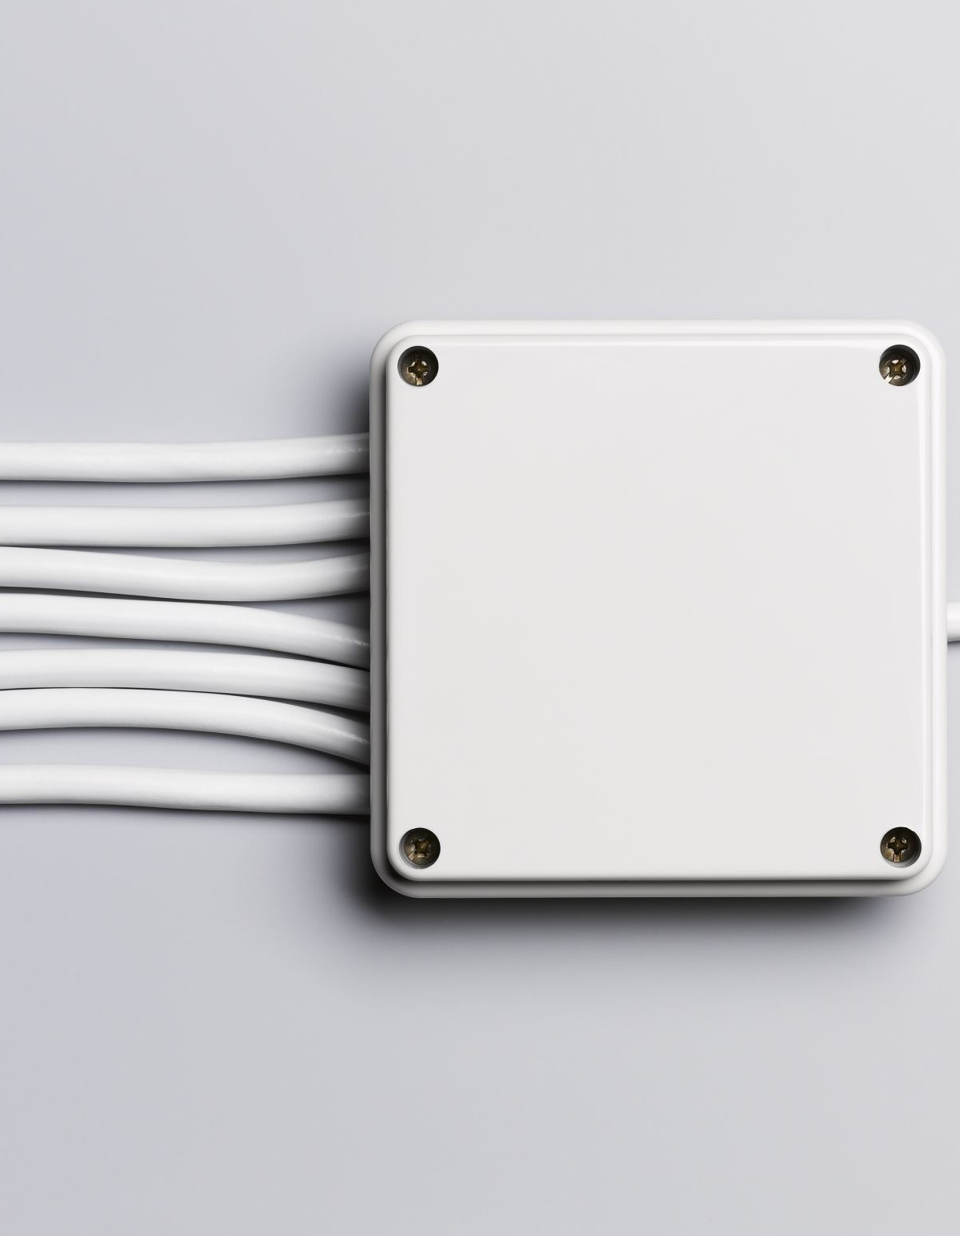
Electrical Equipment
Equipment must be properly grounded to prevent shock injuries.
Ensure there are enough outlets to prevent circuit overloading.
Do not use poorly maintained or non-approved equipment.
Do not drag cords over nails, hooks, or other sharp objects.
Check equipment and receptacles to ensure there are no bare/frayed wires.
Machines should be disconnected before cleaning or adjusting.

Slide 8

Office Furniture
Chairs should be properly designed and regularly inspected for missing casters, wobbly or cracked legs, loose parts.
Do not lean back on a chair with your feet on a desk.
Do not use a chair to move yourself from one area to another.
Do not stand on chairs to reach for something.
Open only one drawer at a time and only use the handles to close drawers.
Do not locate file cabinets close to doorways or in aisles.

Slide 9

Office Machinery
Machines with “nip points” or rotating parts should be guarded to avoid accidental contact.
Machines such as hole punches, paper cutters, and conveyors should be guarded.
Fans must have substantial bases and blades must have guards that are no wider than ½ inch.

Slide 10
Handling & Storage
Improper lifting = musculoskeletal disorders such as sprains, strains, and inflamed joints.
Improperly stored objects can fall on people, cause poor visibility and fires.
Materials should not be stored on top of cabinets.
Heavy objects should be stored on lower shelves, stacked neatly.
Store materials inside cabinets, lockers, or files when possible.
Do not block/obstruct fire extinguishers, fire alarm boxes, or fire suppression equipment.
Identify and properly store flammable and combustible material.
Do not block or obstruct aisles or walkways.
Ensure shelves are secured to the wall to prevent tipping.
Do not step on shelves or stand on chairs to reach items

Slide 11
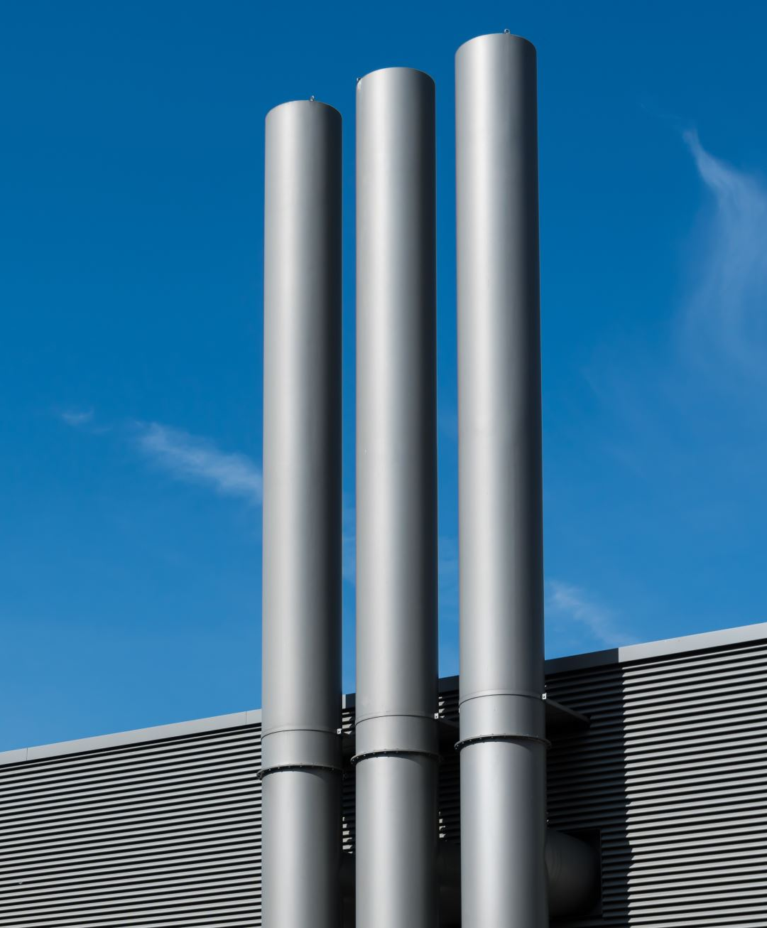
Ventilation
Sources of office air pollution that can cause health problems include:
Natural agents (e.g. carbon monoxide, microorganisms, radon).
Synthetic chemicals (e.g. formaldehyde, cleaning fluids, cigarette smoke, asbestos).
Adequate office ventilation system delivering quality indoor air and providing comfortable humidity and temperature is necessary.
If copying or printing machines used = exhaust ventilation system that draws particulates and gases away from breathing zone should be present.
Office machines and ventilation system components should be checked and maintained on a regular basis.

Slide 12
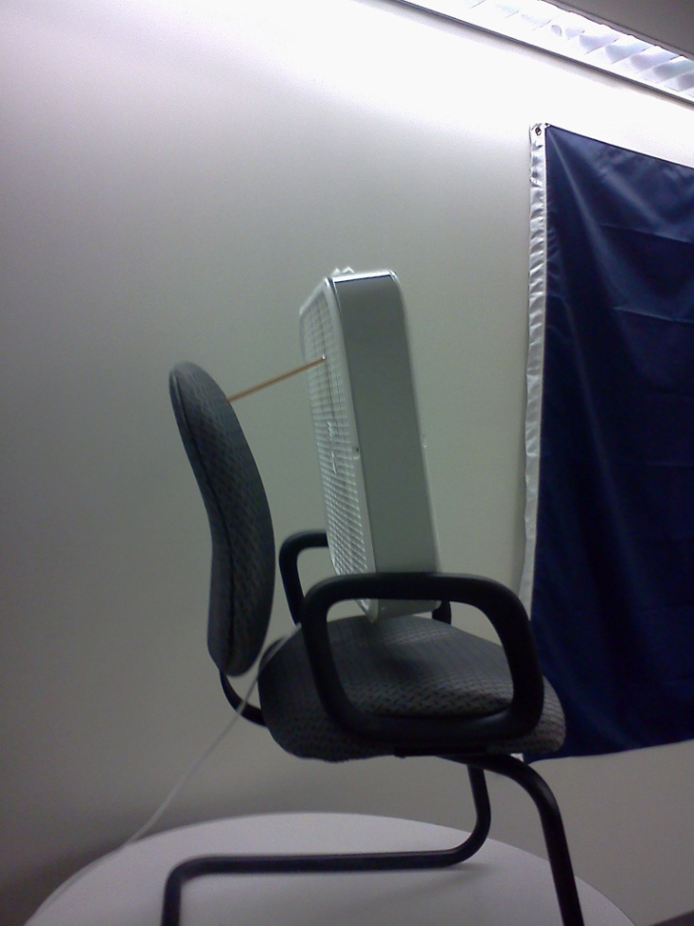
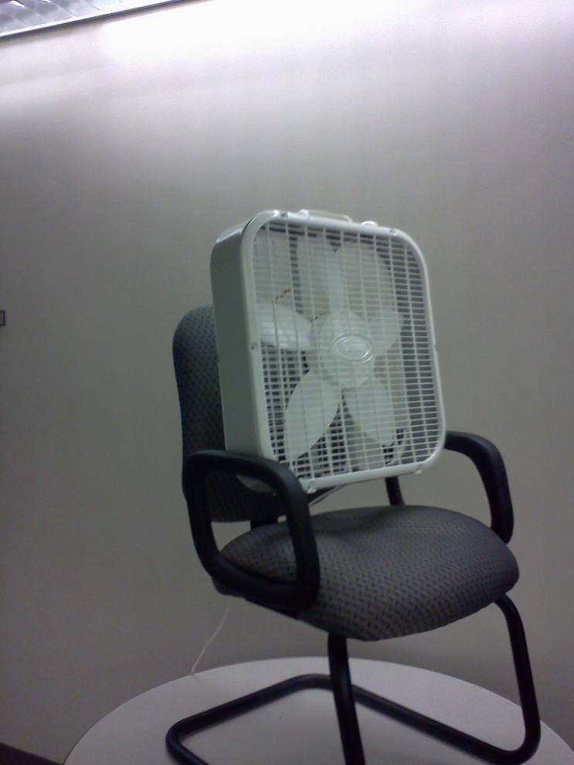
What is wrong with this set-up?
Can someone get injured from this?

Slide 13

Illumination
Poor lighting can cause:
Glare
Shadows
Visual problems (e.g. eyestrain, fatigue, double-vision, etc.)
Accidents/injuries
Controls to prevent poor lighting conditions:
Regular maintenance of the lighting system.
Light-colored dull finish on walls, ceilings, floors to reduce glare.
Adjustable shades on windows.
Indirect lighting.

Slide 14

Noise
Noise can produce tension/stress.
Sources of noise:
Video display terminals.
High-speed printers.
Copying machines.
Telephones.
Human voices.
Housekeeping/Maintenance work.
Measures to control noise:
Place noisy machines in an enclosed space.
Use carpeting, draperies, and acoustical ceiling tiles.
Adjust telephone volumes to lowest level.
Rearrange traffic routes within the office = reduces traffic within/between work areas.
Use less noisy vacuums.
Schedule Housekeeping/Maintenance services after work hours.

Slide 15

Physical Layout
Poor design/layout can lead to crowding, lack of privacy, slips, trips, falls.
At least 3 feet distance between desks; 50 square feet per employee.
Keep telephone and electrical cords/wires out of aisles and walkways.
Keep office machines away from edges of desks/tables.
Regularly inspect, repair, and replace damaged carpets.
Place floor mats inside building entrances.

Slide 16
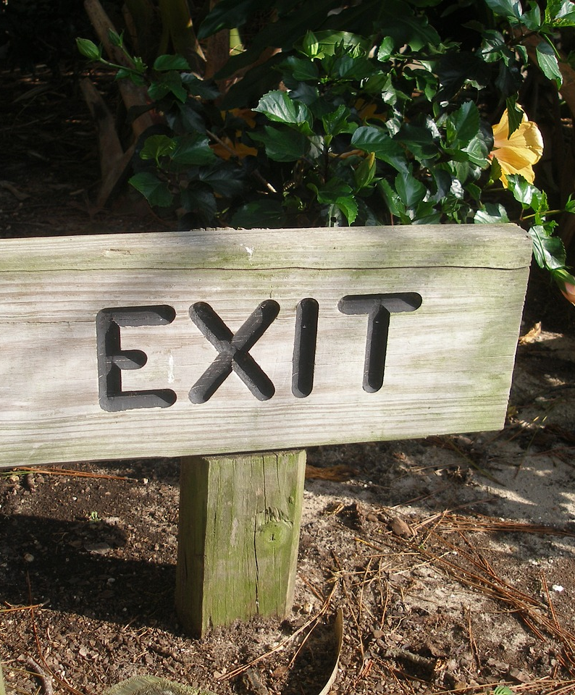
Exit/Egress
All exits should be at least 28 inches wide.
Generally two exits should be provided.
Exits and access must be marked as such.
Means of egress should be free of obstructions and adequately lit (includes stairways used for emergency exit).
All employees should be aware of exit locations and trained in proper evacuation procedures

Slide 17

Ladders, Stands, and Stools
Always face the ladder when going up or down.
Inspect ladders regularly to ensure they are in good condition.
Never stand or sit on the top step of a ladder.
Ladders should only be used when they are fully opened and the spreaders are locked.
Ensure the ladder/stool used is tall enough to be used safely.
Before using ensure ladders/stools/stands are on solid surfaces that are not slippery.

Slide 18

Ergonomic Tips and Considerations
If you do same tasks with your hands over and over: try not to bend, extend, or twist hands for long periods.
Don’t work with your arms too close or too far from your body.
Don’t rest your wrists on hard surfaces for long periods.
Switch hands during work tasks if possible.
Take regular breaks from repeated hand movements: give your hands and wrists time to rest.
Don’t sit or stand in the same position all day.
Ensure your chair is adjusted so your forearms are level with your keyboard, and you don’t flex your wrists to type.

Slide 19

Computers: Guiding Principles
Screen – Top should be at or just below eye level and approximately 18-22 inches away.
Chair – Your back should be fully supported with feet flat on the floor or on a footrest. Knees should be approximately 90 degrees to floor when seated.
Keyboard – At a height so wrists are straight and elbows at approximately 90 degrees.
Document Holder – Place at same height and distance as screen.
Eye Comfort – Reduce glare on screen by controlling light from uncovered windows. Set screen at right angle to window if possible.
Change Positions – Frequently change positions to release tension on the body.
Organize Work Area – Keep frequently used items such as the telephone within easy reach.
Exercise – Take mini-breaks throughout the day to relieve muscle tension and reenergize the body

Slide 20
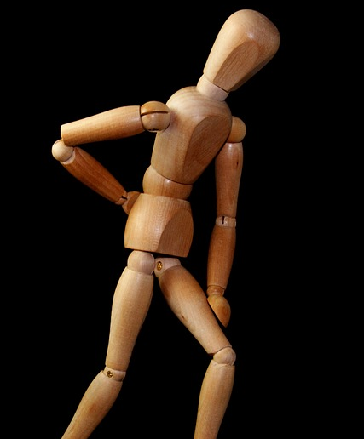
Back Problems
Heavy lifting from above the shoulders.
Heavy lifting from below the knees.
Twisting while lifting/carrying.
Bending over at the waist.
Carrying objects to one side.

Slide 21
Proper Lifting
Assess the load
Consider if you need to lift the load, and if possible, where you'll put it. If the load is too heavy or awkward, don't try to lift it by yourself. You can also break up the load into smaller, lighter items.
Get into position
Squat down to the load with your knees and hips bent, keeping your back straight and in its natural arch. Position your feet shoulder-width apart, with one foot in front of the object and the other behind it. Tighten your core muscles.
Lift slowly
Use smooth movements to straighten your hips and knees, lifting the load close to your body at belly button level. Keep your shoulders in line with your hips, and don't twist.
Carry the load
Carry the load straight ahead, and try to maintain its close proximity to your body for as long as possible. Position the heaviest side of the load next to you.
Set it down
Carefully lower the load by squatting with your knees and hips.

Slide 22
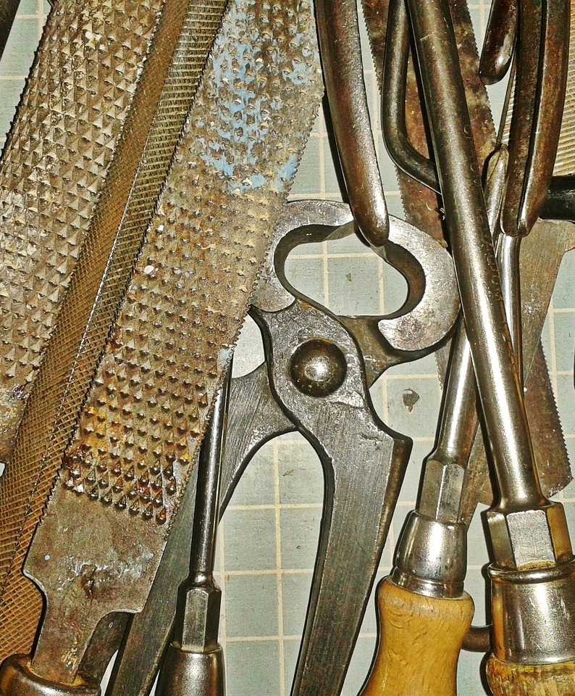
Tools
Office tools such as pens, pencils, paper, letter openers, scissors, and staplers can cause cuts, scrapes, punctures with resulting infections.
Paper cutter blades should be closed when not in use and a guard should be in place.
Always use staple removers and never test a jammed stapler with your thumb.
Store sharp objects in a drawer or with the point down.
Never hand a sharp object to someone point first.

Slide 23
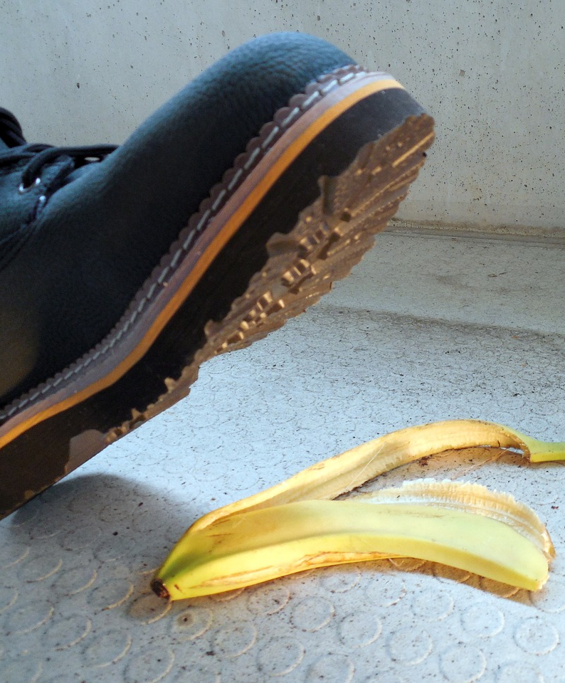
Fall Prevention
Wear appropriate footwear = sturdy shoes with non-slip soles.
Maintain a clear line of vision.
Install convex mirrors around blind corners or cubicle walls to avoid collisions.
Don’t run electrical cords, telephone/computer wiring across walkways.
Do not stand on chairs or other furniture to reach for something.
Do not store boxes, files, or various other items in walkways.
Use handrails when walking up or down stairs.
Close all file drawers immediately after use.
Close the file drawer using the drawer handle, not your feet.
Open only one file drawer at a time (to avoid causing cabinet to fall over).
Never leave an open drawer unattended.
Never open a drawer while someone is beneath it.
Never climb on open file drawers

Slide 24
Summary
There are many hazards associated with working in an office environment.
Be aware of safety issues/hazards; report them, correct them.
Realize an improper or careless act such as leaving a file drawer open can cause injuries.
Think safety, act safely!

Slide 25

Questions?

